Slide 1


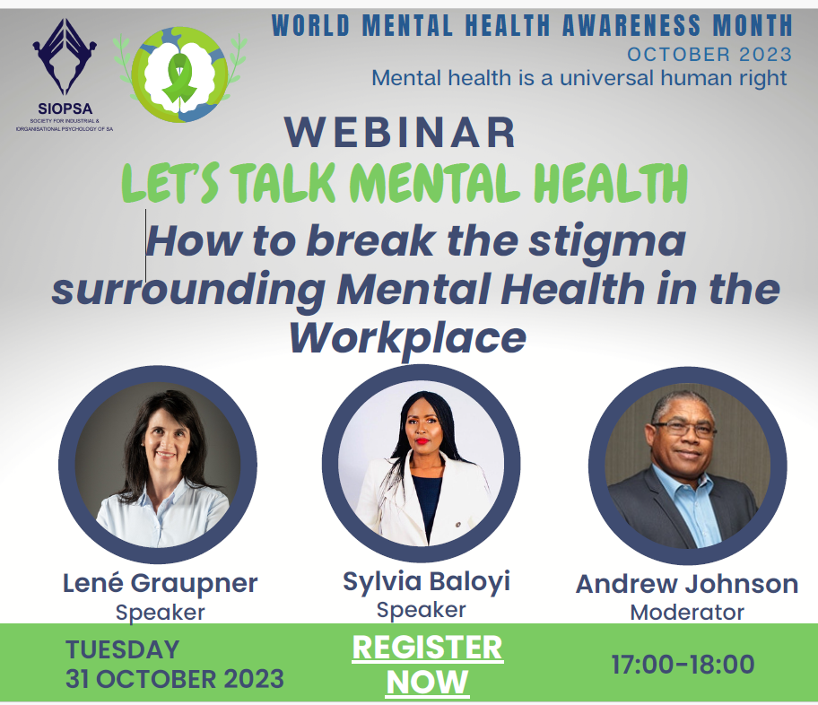

PROFESSIONAL PRACTICE
WORKPLACE COUNSELLING COMMITTEE
Notes:
Thank you for saying YES!

Slide 2

Introducing Professional Practice (PP)
Professional Practice Chair
CPD
Ethics and Professional sustainability
Workplace Counselling

Slide 3
PP portfolio objectives
Portfolio objectives
  enhance professional competence and improve performance
  advise in applied ethics and supporting professional sustainability
  adhere to the highest academic, professional and ethical standards
  provide excellent quality assurance,
  give advice for all CPD related activities
  oversee the workplace counselling sub-committee

Slide 4

How to break the stigma around mental health in the workplace
Notes:
Thank you for saying YES!

Slide 5

Stigma
Mental health issues
What to do?
Talking points

Slide 6
Stigma

Slide 7
WHO ON STIGMA
“Mental health ‘is a universal human right” to improve knowledge, raise awareness and drive actions that promote and protect everyone’s mental health as a universal human right.
“Challenge the stigma and discrimination surrounding mental health.
All have the right to live our lives free from stigma and discrimination in places like schools and workplaces”.
https://www.who.int/campaigns/world-mental-health-day/2023

Slide 8
WHAT IS STIGMA
Stigma is a negative label used to identify people with mental health issues
Stigma is a mark, a stain or a blemish
People are viewed in a negative way and treated differently
Stigma can also lead to discrimination, and this in turn can make mental illness worse.

Slide 9
EFFECTS OF STIGMA
Internalise the stigma
Negative Feelings.
Negative perception
Experience discrimination

Slide 10
Mental health issues

Slide 11
Mental health
An integral part of our general health, well-being and a basic human right.
Good mental health means we are better able to:
Connect
Function
Cope
Thrive
Complex continuum:
ranging from an optimal state of well-being to
debilitating states of great suffering and emotional pain.
WHO (2022)

Slide 12
Most common mental health issues 2023
Depression
Anxiety
Adverse Childhood Expe
Suicidal thoughts
Financial wellbeing
Craig et al (2022); EAPA-SA (2023); WHO (2022)

Slide 13
Depression - most prevalent mental health issue suffered by employees in the workplace.
Only between 15% to 25% will seek and receive help
Employee absenteeism (due to depression) costs the SA economy approx R19-billion annually
In 2022 South Africa ranked as one of the worst countries regarding mental health
Around 27% of South Africans suffer from depression
Approx 350 million people suffer from depression around the world
One quarter of South African employees will be diagnosed with depression during the course of their employment
EAPA-SA (2023)

Slide 14
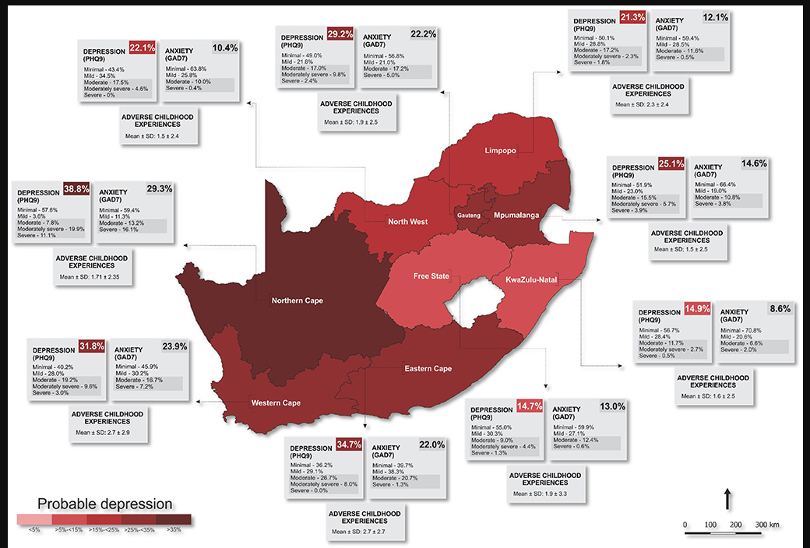
Craig et al. (2022)

Slide 15
More than a quarter of the participants reported moderate to severe depression with higher levels in certain provinces.
Probable anxiety and Adverse childhood experiences(ACE) exposure differs across the provinces.
Depression and anxiety were more frequently observed among:
Mental health risk has associations with poverty and with higher prevalence previously reported in rural areas
older, widowed, divorced, or separated adults
those with less education
fewer household assets
and/or higher ACE exposure.
Craig et al. (2022); EAPA-SA (2023)

Slide 16
How to spot mental health issues at work/ what to look for:
Uncharacteristic behaviour
Low levels of engagement
Decreases in productivity
Changes in sleeping or eating behaviours
Disinterest in work or day-to-day activities
Increased absence
Changes in working patterns
Withdrawal from social situations
Irrational fears, paranoia or anxiety
Substance use/misuse
Pindar (2023)

Slide 17
What to do?

Slide 18
HOW TO HANDLE STIGMA
Policies and procedures to deal with mental health
Mental health education and programs
Find out more about it
Join a Support Group
Seek help
Embrace mental health

Slide 19
(Updated) Comprehensive Mental Health Action Plan 2013-2030 (WHO):
Actions to promote mental health and well-being for all
To prevent mental health conditions for those at-risk and to achieve universal coverage for mental health services.
Four objectives:
more effective leadership and governance for mental health
the provision of comprehensive, integrated mental health and social care services in community-based settings
implementation of strategies for promotion and prevention
strengthened information systems, evidence and research
WHO (2022)

Slide 20
Employers should adopt a proactive approach:
Educating employees on mental health issues
Training managers on how to identify early signs of mental health issues
Support employees by regular communication with them
If the mental health issue is likely to impair the employee's performance permanently, the employer must attempt first to reasonably accommodate the employee’s disability.
This may be ascertaining whether alternative work can be found for the employee, even if it is at reduced remuneration.
Procedural fairness:
The employee has been properly counselled and the impact of their mental health issues on their performance or conduct has been discussed with them.
An employee must also be provided with a fair opportunity to contest the employer's conclusions about their mental health issues.
Inform how it may impact their work performance
Encouraging employees to utilise their annual leave to rest and recuperate from time to time
The Code of Good Practice:
Craig et al. (2022); Labour relations act; Ramjettan et al. (2020)

Slide 21
Support others in crisis:
Once warning signs are spotted, what to do next?
CLASS-approach 5-step guide:
Connect
Check in
Listen
Time to talk
Assess
Connect with services
Make time
Show concern
Micro skills
Support
Signpost
Establish intentions
Id protective factors
Explore available support
GP (ER)
Plan action steps
Pindar (2023)

Slide 22
References
https://www.eapasa.co.za/the-state-of-mental-health-in-south-africa/
Managing mental health issues in the workplace: by Dhevarsha Ramjettan, Nivaani Moodley, Siya Ngcamu: 02 Sep 2021
https://sapienlabs.org/wp-content/uploads/2022/03/Mental-State-of-the-World-Report-2021.pdf]
https://www.polity.org.za/article/managing-mental-health-related-issues-in-the-workplace-2021-09-02
https://www.sadag.org/index.php?option=com_content&amp;view=article&amp;id=2391:new-research-on-depression-in-the-workplace&amp;catid=11:general&amp;Itemid=101&Itemid=101
https://www.alexanderforbes.co.za/download/afo/benefitsbarometer/Benefits%20Barometer%202018/Benefits%20Barometer%202018%20-%20Part%203%20Chapter%204.pdf
Craig A, Rochat T, Naicker SN, Mapanga W, Mtintsilana A, Dlamini SN, Ware LJ, Du Toit J, Draper CE, Richter L and Norris SA (2022) The prevalence of probable depression and probable anxiety, and associations with adverse childhood experiences and socio-demographics: A national survey in South Africa. Front. Public Health 10:986531. doi: 10.3389/fpubh.2022.986531
WHO (2022) https://archive.hshsl.umaryland.edu/bitstream/handle/10713/20295/WHO%20Report%202022.pdf?sequence=1&isAllowed=y
Dhevarsha Ramjettan, Nivaani Moodley, Siya Ngcamu and Shane Johnson from Webber Wentzel. * Legal Aid South Africa v Jansen [2020] 11 BLLR 1103 (LAC). https://www.polity.org.za/article/managing-mental-health-related-issues-in-the-workplace-2021-09-02
Labour Relations Act 66 of 1995. Code of Good Practice on Dismissals Based On Operational Requirements. CODE OF GOOD PRACTICE ON DISMISSALS BASED ON OPERATIONAL REQUIREMENTS. 12 Operational requirements

